Slide 1
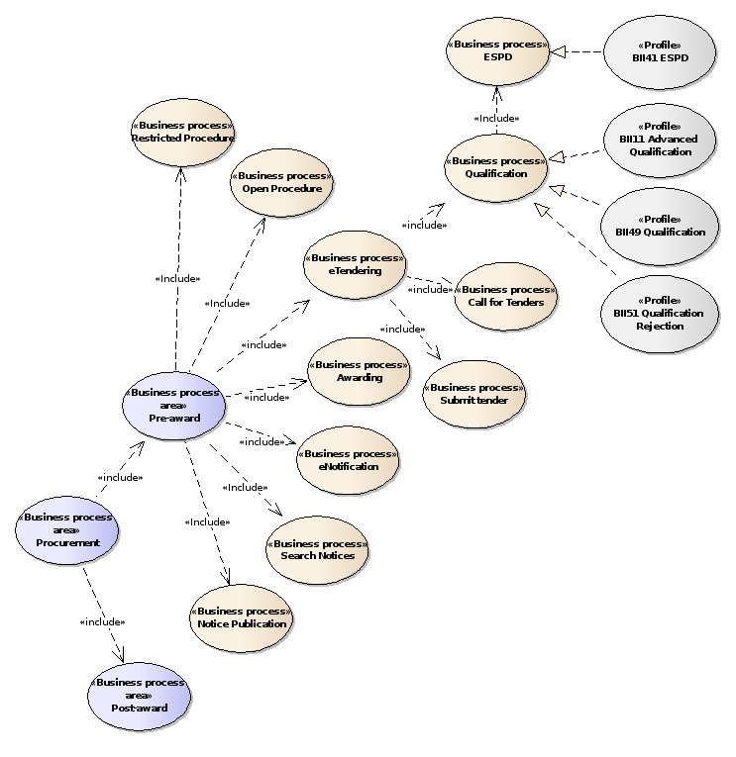

Slide 2
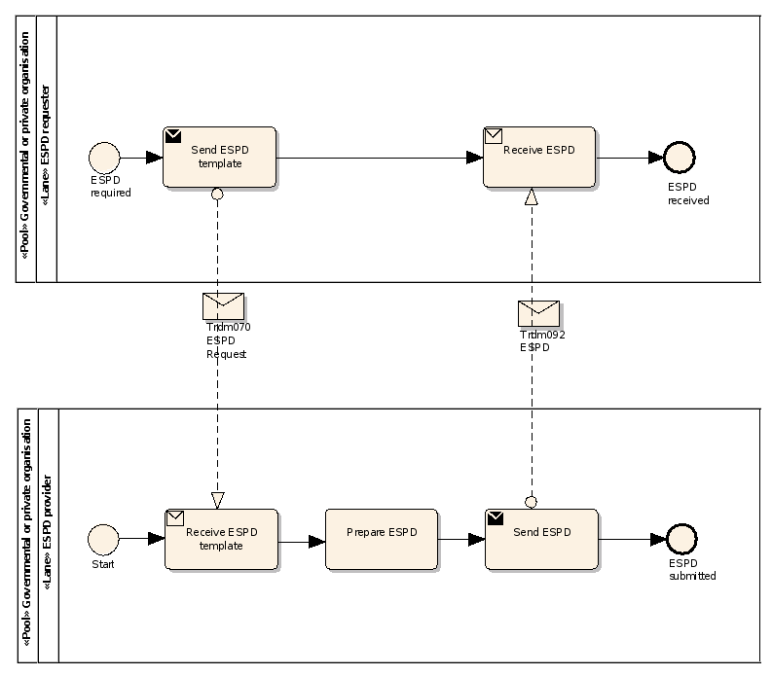
QualificationApplicationRequest
QualificationApplicationResponse

Slide 3
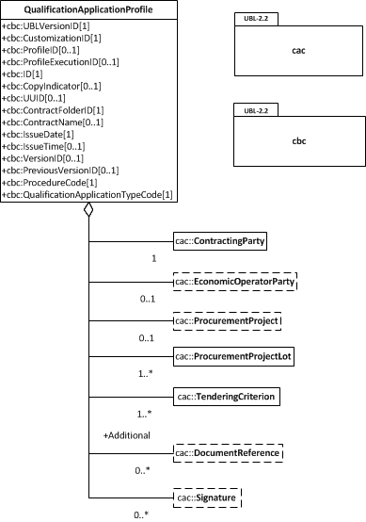

Slide 4
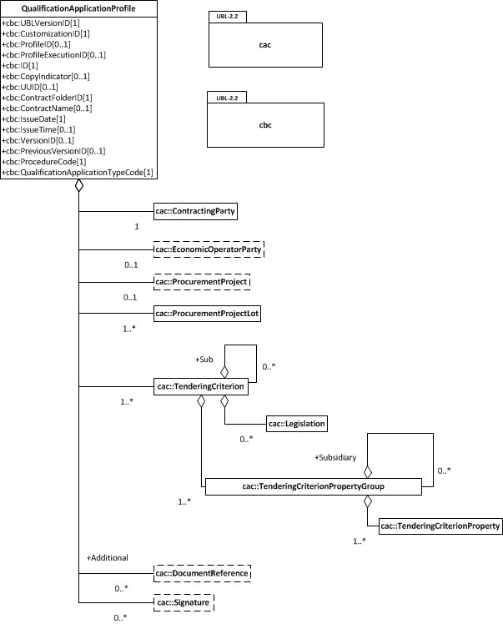

Slide 5
EXCLUSION
CONVICTIONS
PARTICIPATION_IN_CRIMINAL_ORGANISATION, CORRUPTION, FRAUD, TERRORIST_OFFENCES,
MONEY_LAUNDERING, CHILD_LABOUR-HUMAN_TRAFFICKING
CONTRIBUTIONS
PAYMENT_OF_TAXES, PAYMENT_OF_SOCIAL_SECURITY
SOCIAL
ENVIRONMENTAL_LAW, SOCIAL_LAW, LABOUR_LAW
BUSINESS
BANKRUPTCY, INSOLVENCY, CREDITORS_ARRANGEMENT, BANKRUPTCY_ANALOGOUS,
LIQUIDATOR_ADMINISTERED, ACTIVITIES_SUSPENDED
MISCONDUCT
MC_PROFESSIONAL, MARKET_DISTORSION
CONFLICT_OF_INTEREST
PROCEDURE_PARTICIPATION, PROCEDURE_PREPARATION
EARLY_TERMINATION
EARLY_TERMINATION, MISINTERPRETATION
NATIONAL
OTHER

Slide 6
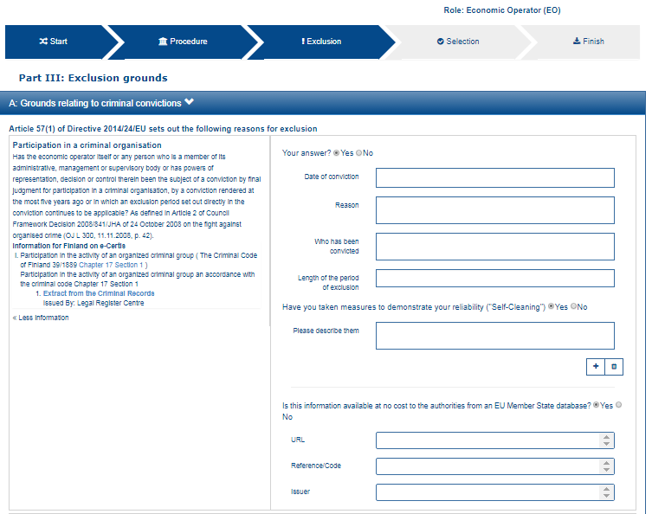
1
2
3
12
4
13
5
6
7
8
9
11
12

Slide 7
12
13

Slide 8
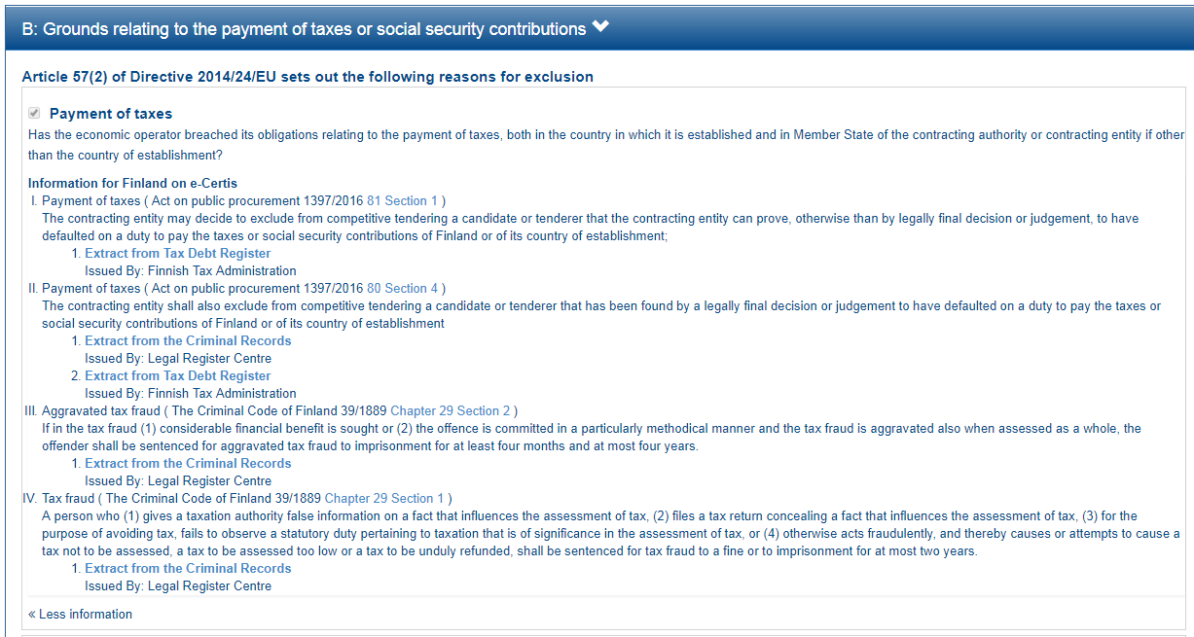

Slide 9
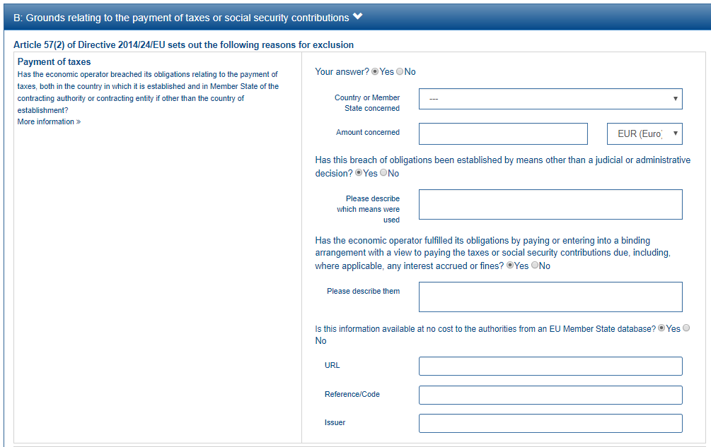
1
2
3
This property is shown only if the answer to the previous QUESTION is ‘Yes’
4
5
6
7
8

Slide 10
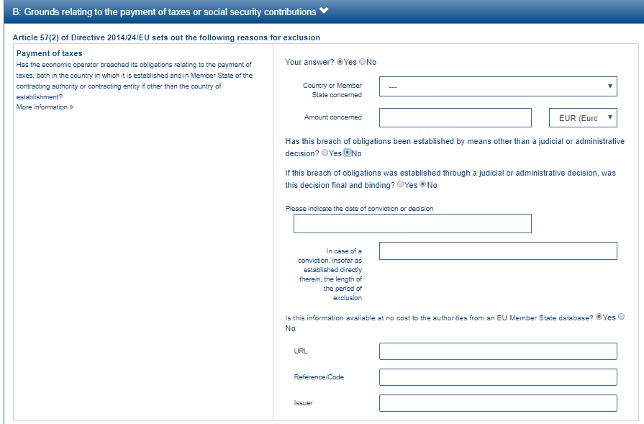
This group of property is shown only if the answer to the previous QUESTION is ‘No’
9
10

Slide 11
EU PoT Criterion
1
FI PoT Criterion I
2
FI PoT Criterion II
3
FI PoT Criterion III
4
FI PoT Criterion IV
5

Slide 12
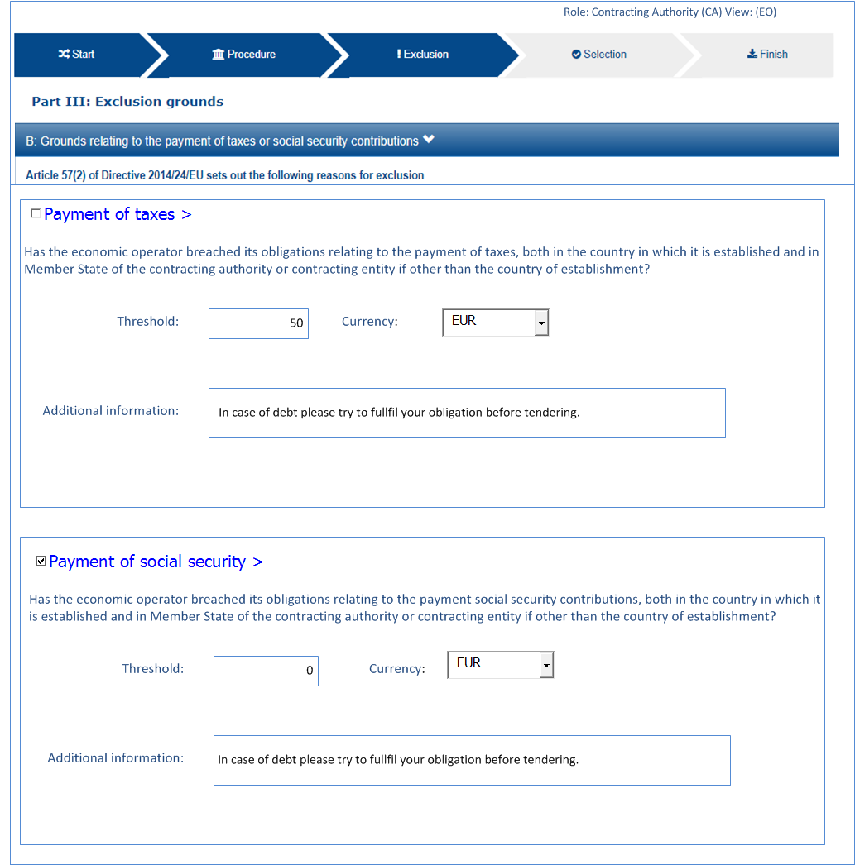
6
7
8

Slide 13
6
7
Minimum threshold: 50€
In case of debt please try to fulfil your obligation before tendering
8

Slide 14
2
3
4
5

Slide 15
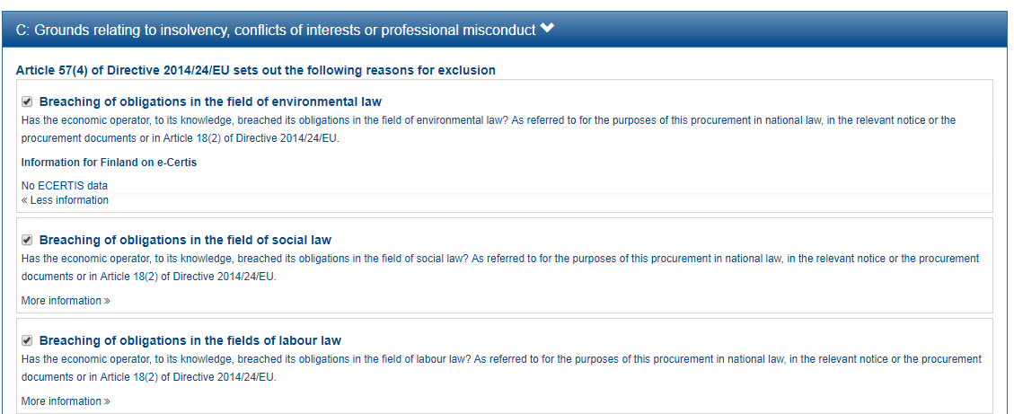

Slide 16
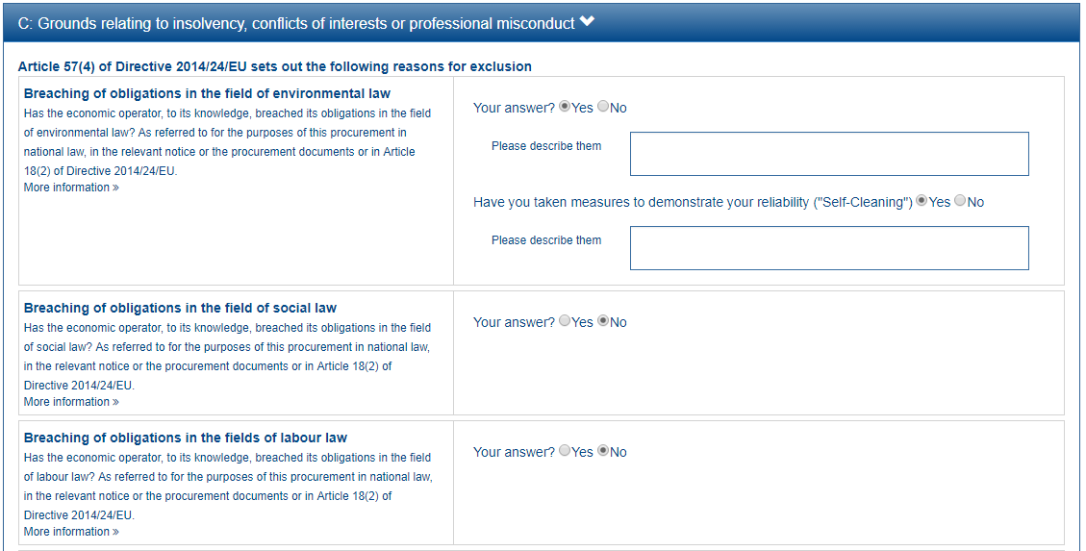
1
2

Slide 18
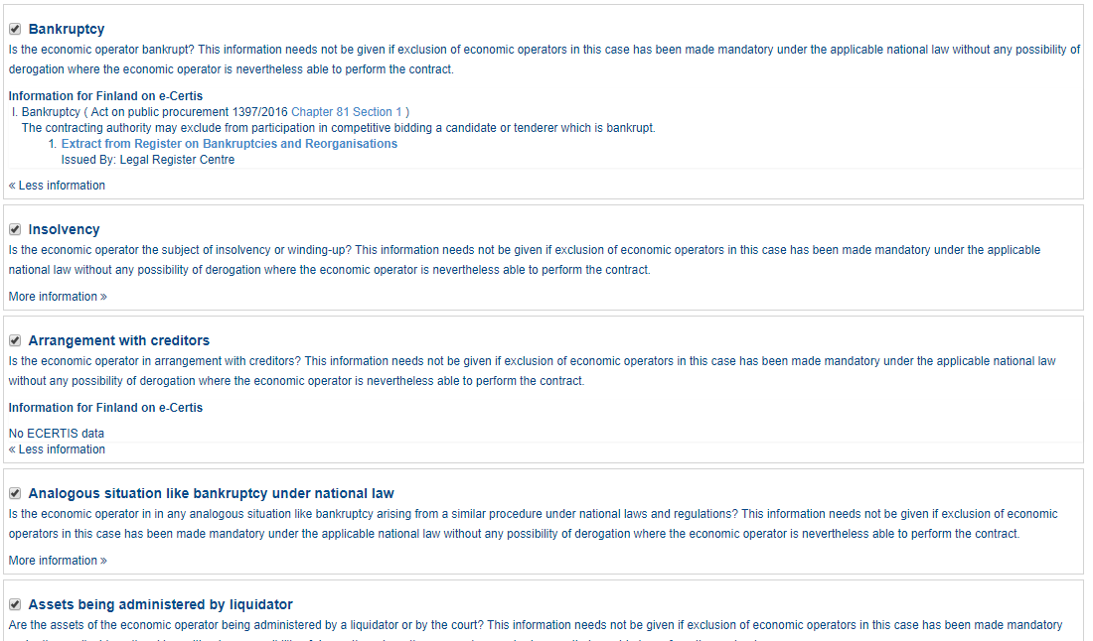

Slide 19
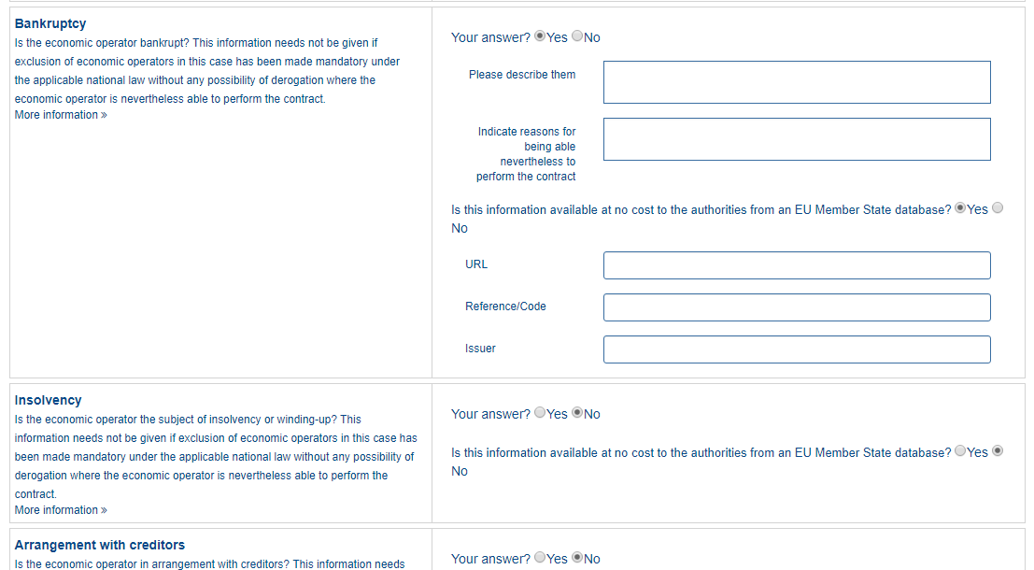
1
2
3
4
5
6

Slide 22
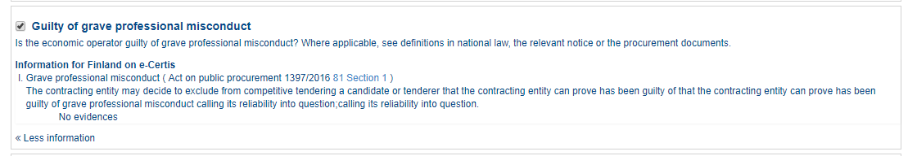

Slide 23
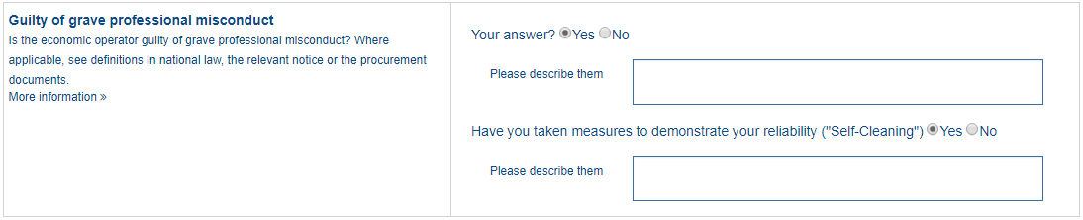
1
2

Slide 26
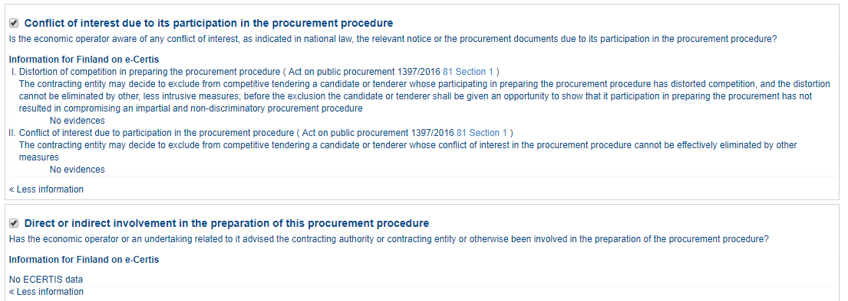

Slide 27
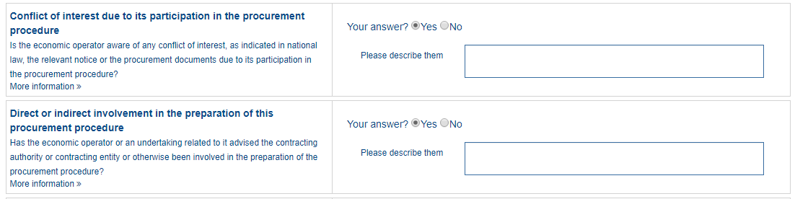
1

Slide 30
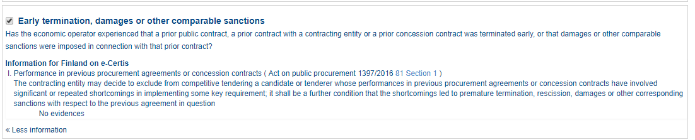

Slide 31
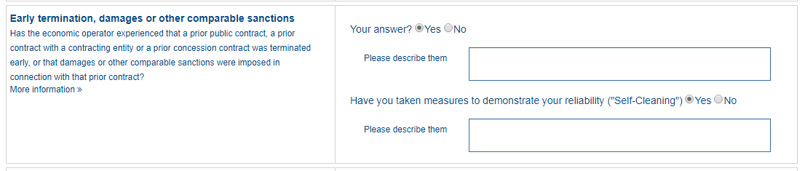
1
2

Slide 32
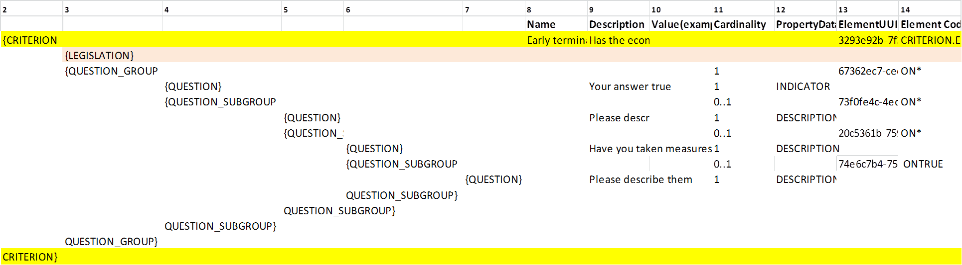

Slide 34
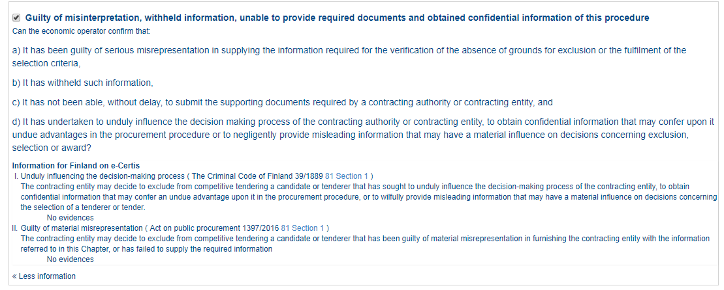

Slide 35
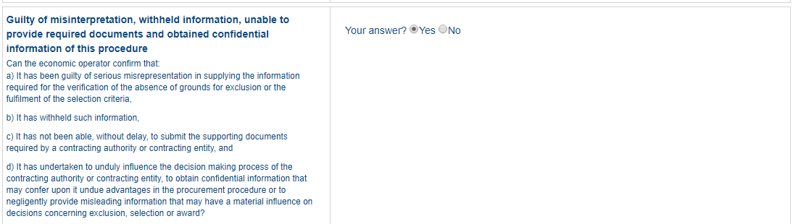
1

Slide 37
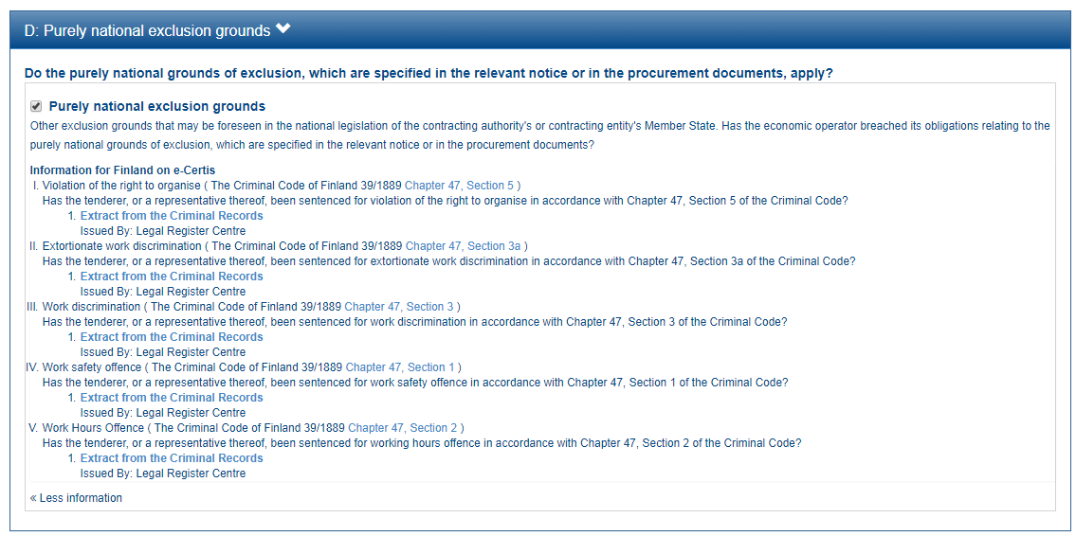

Slide 38
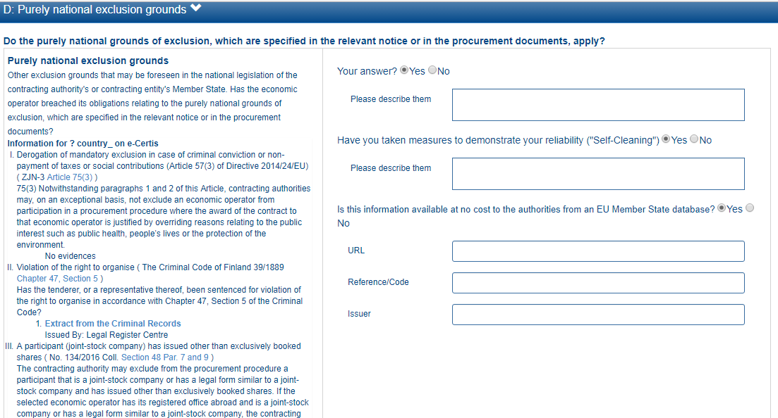
1
2
3
4
5
6

Slide 39
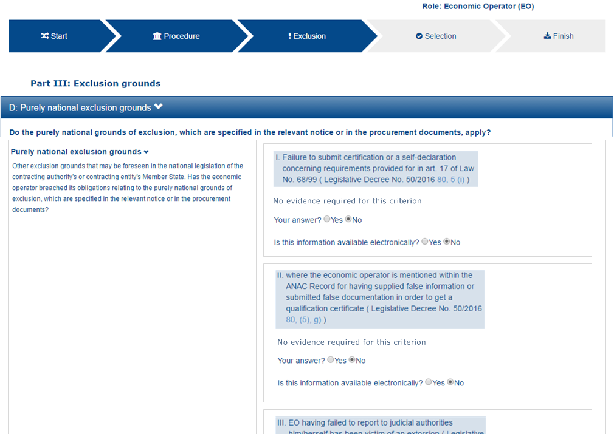
1
2

Slide 42
SELECTION
ECONOMIC_FINANCIAL_STANDING
PROFESSIONAL_REGISTER_ENROLMENT, TRADE_REGISTER_ENROLMENT
ECONOMIC_FINANCIAL_STANDING
TURNOVER
GENERAL_YEARLY, SPECIFIC_YEARLY
GENERAL_YEARLY, SPECIFIC_YEARLY
SET_UP
FINANCIAL_RATIO
RISK_INDEMNITY_INSURANCE
OTHER_REQUIREMENTS
TECHNICAL_PROFESSIONAL_ABILITY
REFERENCES
WORKS_PERFORMANCE, SUPPLIES_DELIVERY_PERFORMANCE, SERVICES_DELIVERY_PERFORMANCE
TECHNICAL.TECHNICIANS_FOR_QUALITY_CONTROL, TECHNICAL.TECHNICIANS_FOR_CARRYING_WORKS, TECHNICAL.FACILITIES_FOR_QUALITY_ENSURING, TECHNICAL.FACILITIES_FOR_STUDY_RESEARCH, TECHNICAL.SUPPLY_CHAIN_MANAGEMENT, TECHNICAL.PROFESSIONAL_QUALIFICATIONS, TECHNICAL.ENVIRONMENTAL_MANAGEMENT_MEASURES, TECHNICAL.EQUIPMENT
TECHNICAL.CHECKS.ALLOWANCE_OF_CHECKS
MANAGEMENT.MANAGERIAL_STAFF, MANAGEMENT.AVERAGE_ANNUAL_MANPOWER
MANAGEMENT.SUBCONTRACTING_PROPORTION
MANAGEMENT.ARTEFACTS.NO_AUTHENTICATED_ARTEFACTS
MANAGEMENT.ARTEFACTS.NO_AUTHENTICATED_ARTEFACTS, MANAGEMENT.ARTEFACTS.AUTHENTICATED_ARTEFACTS
CERTIFICATES.QUALITY_ASSURANCE.QA_INSTITUTES_CERTIFICATE, CERTIFICATES.QUALITY_ASSURANCE.QA_INDEPENDENT_CERTIFICATE

Slide 43
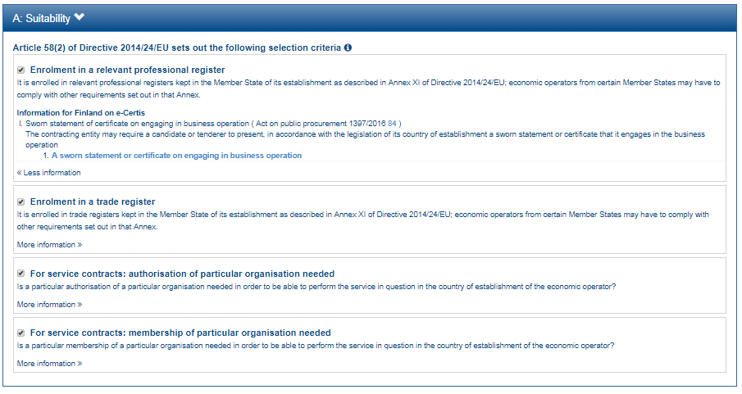

Slide 44
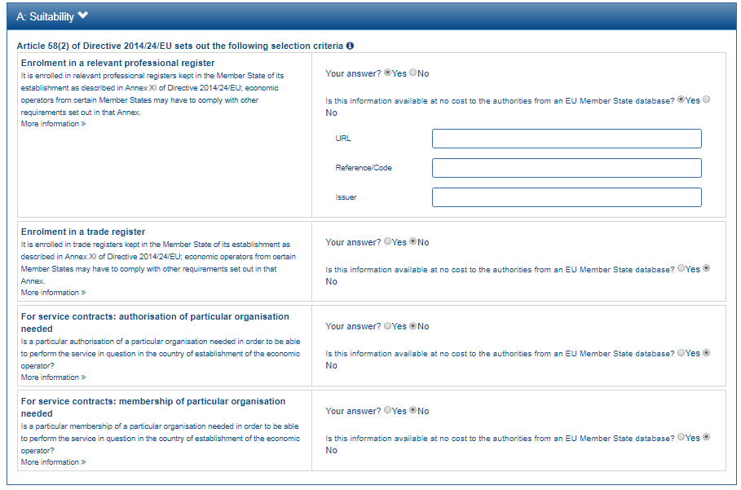
1
2
3
4
5

Slide 46
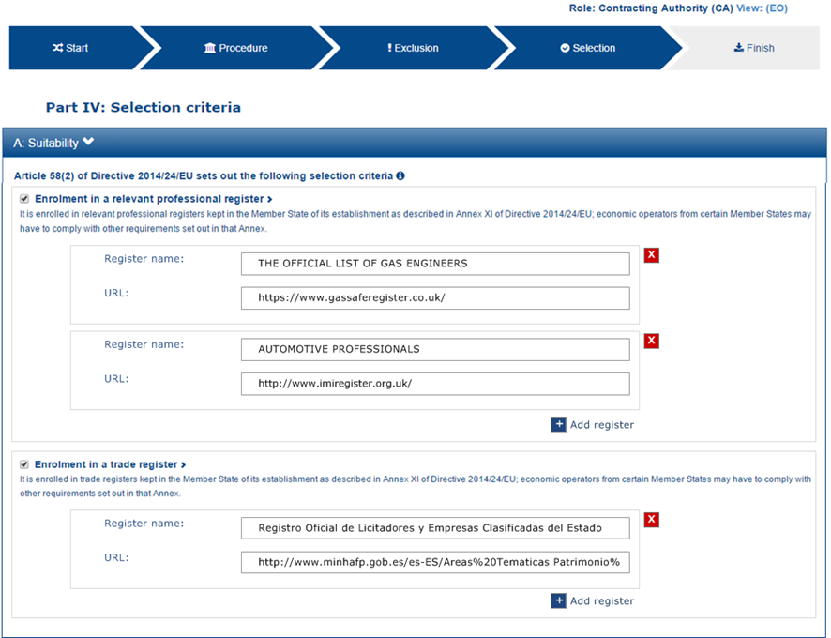

Slide 47
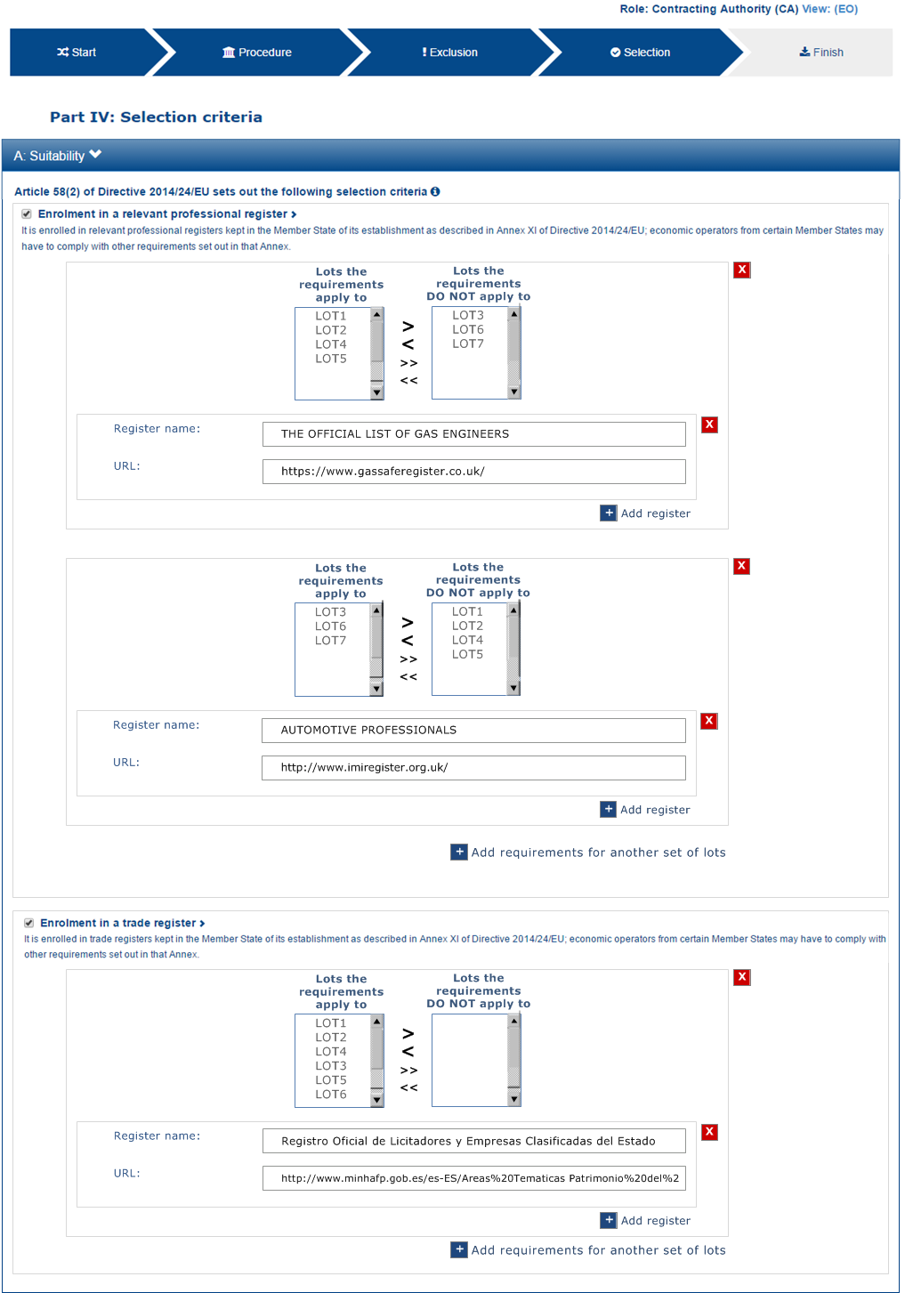
1
2
3

Slide 48
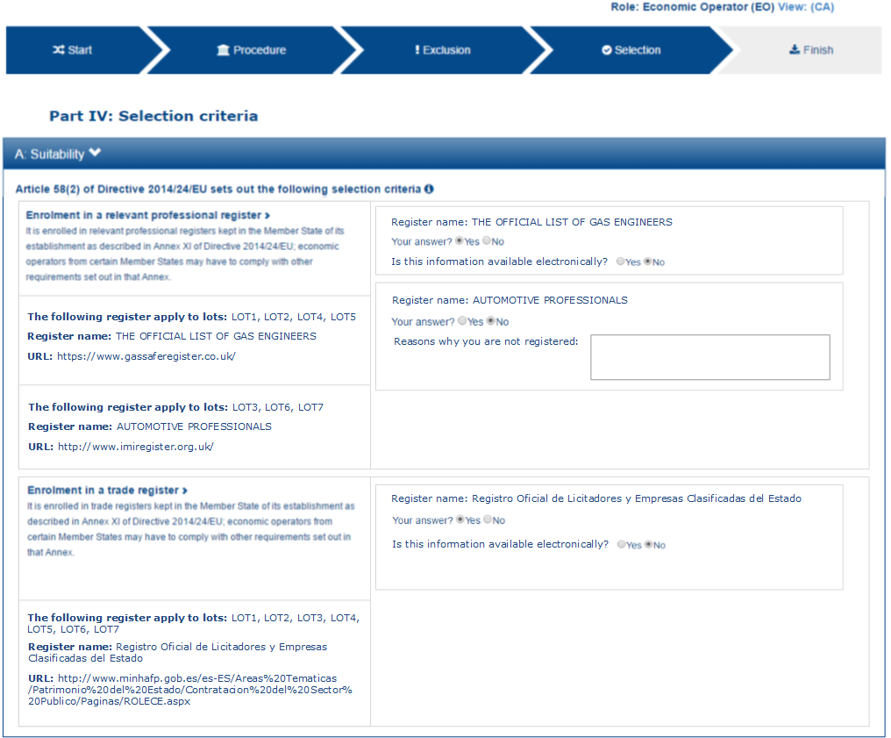
7
8
1
9
2
3
10
4
5
6

Slide 50
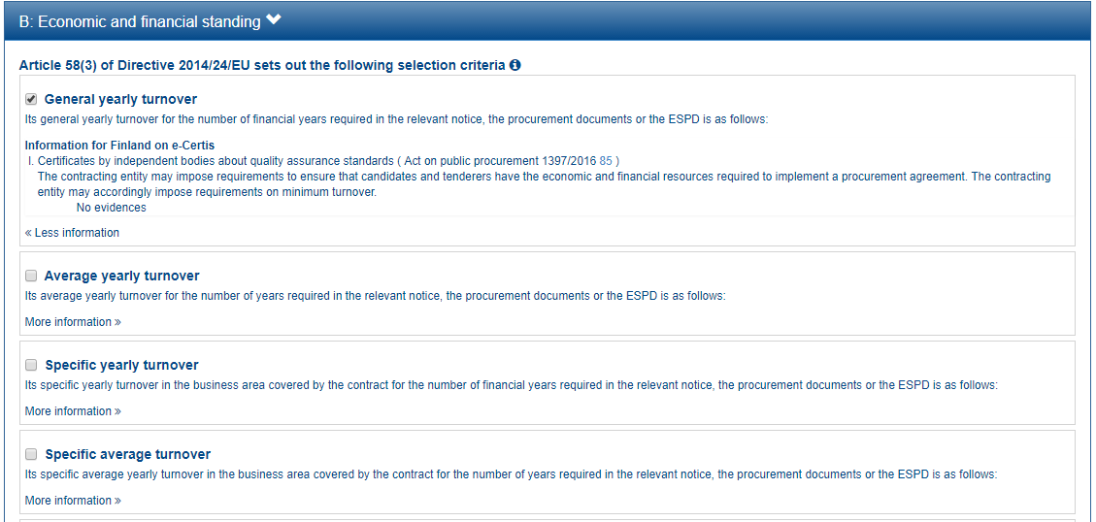
1
2
3

Slide 51
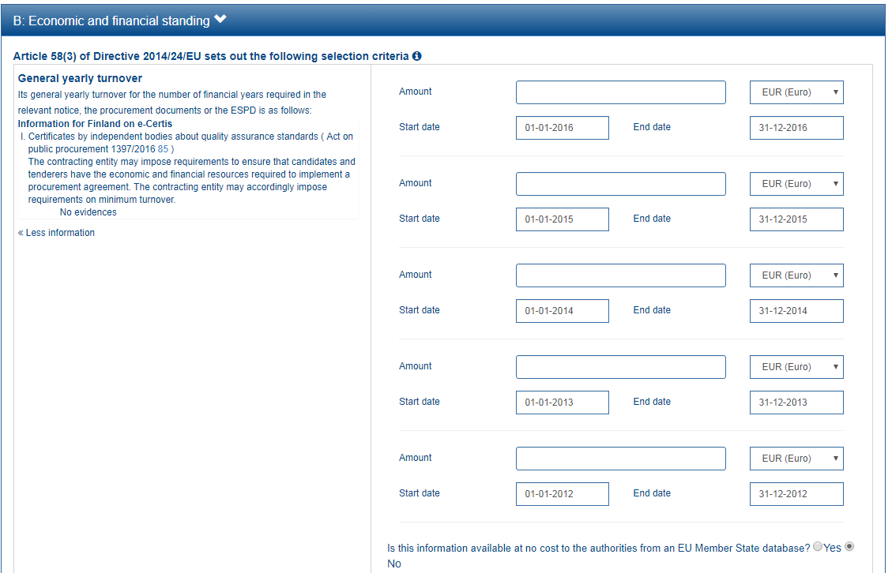
1
4
5
2
6
3
7
8
9
10
11
12
13
14

Slide 53
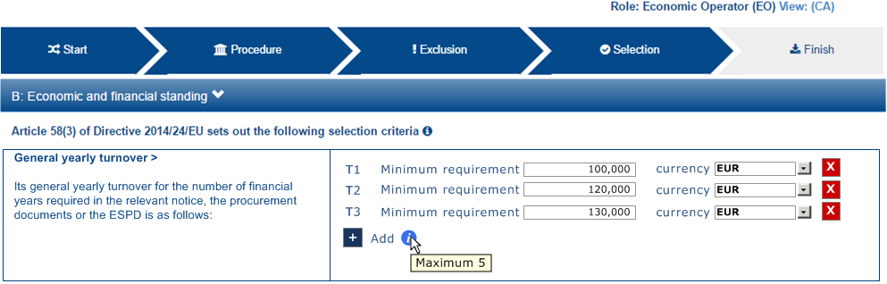
1
2
3

Slide 54
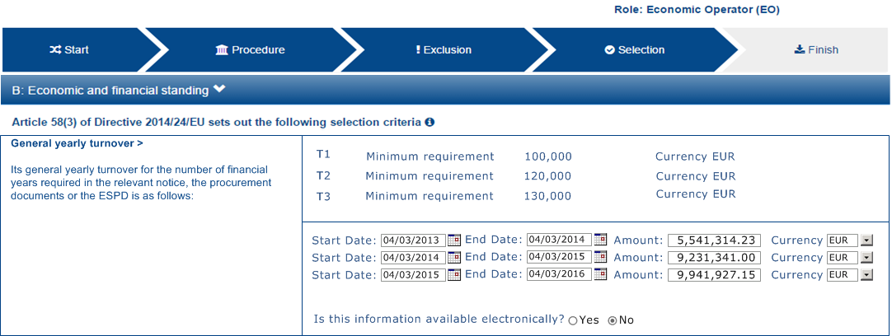
1
2
3

Slide 56
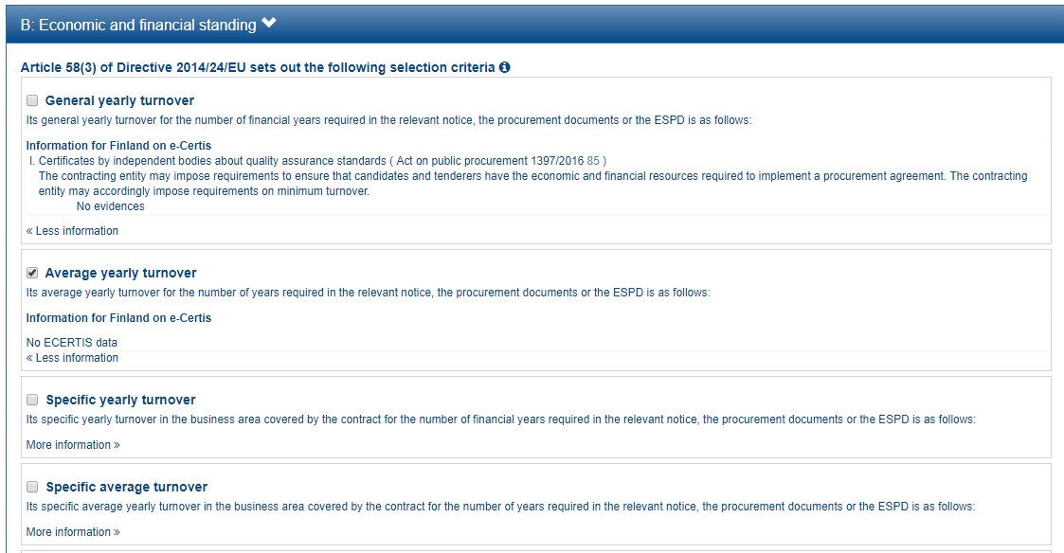
1
2
3

Slide 57
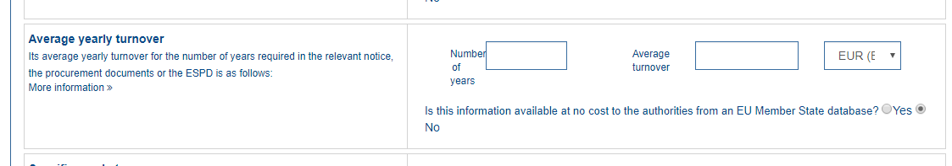

Slide 59
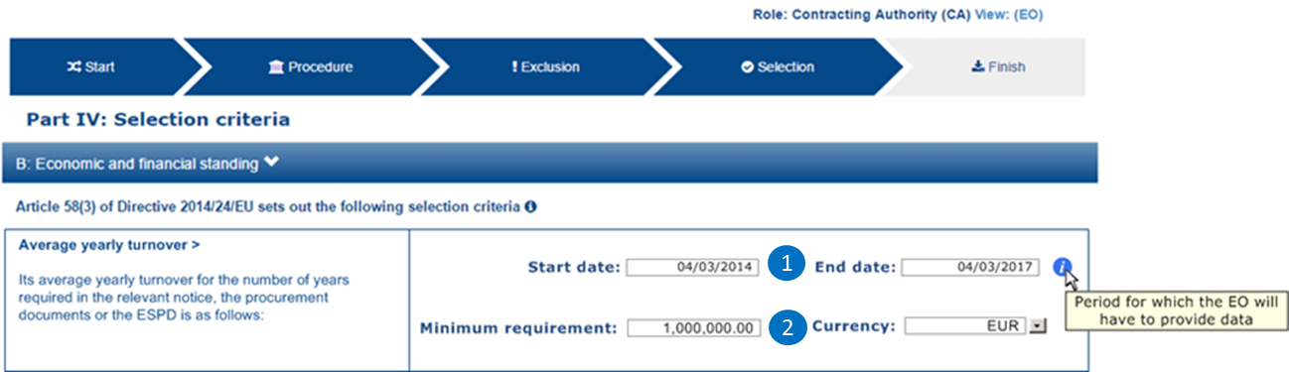

Slide 60
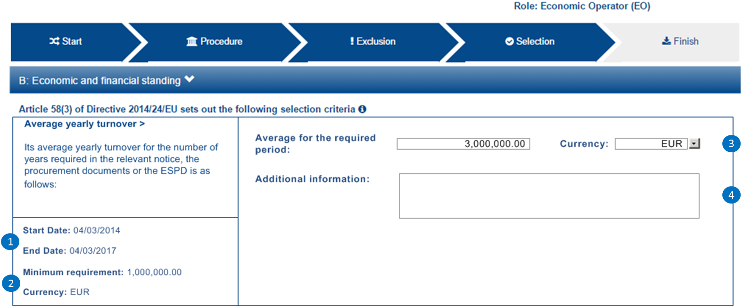

Slide 62
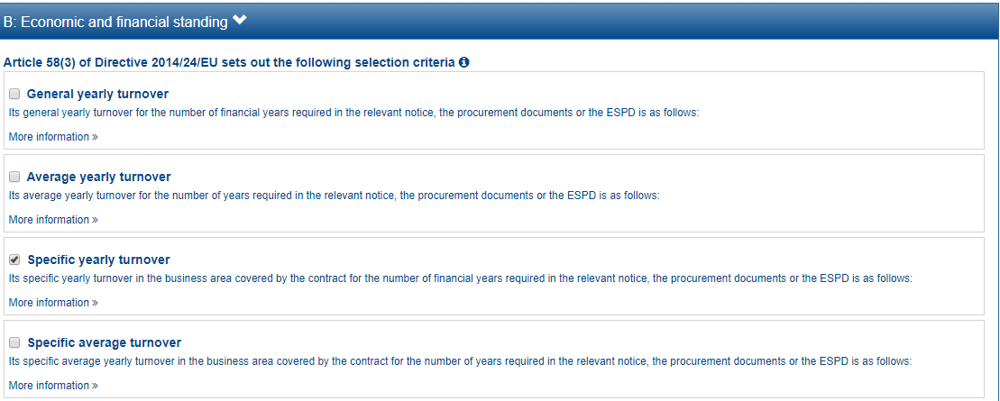

Slide 63
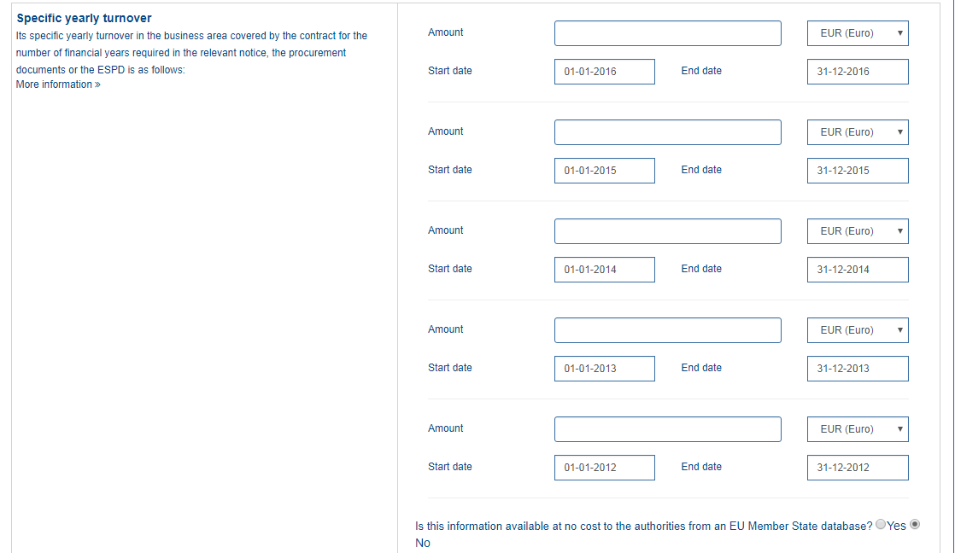
1
2
3
4
5
6
7
8
9
10
11

Slide 65
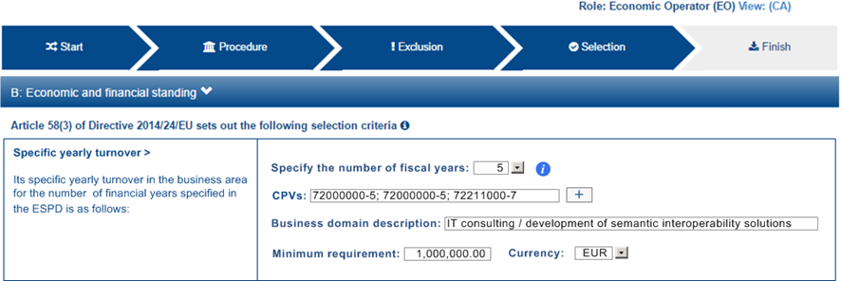
1
2
3
4

Slide 66
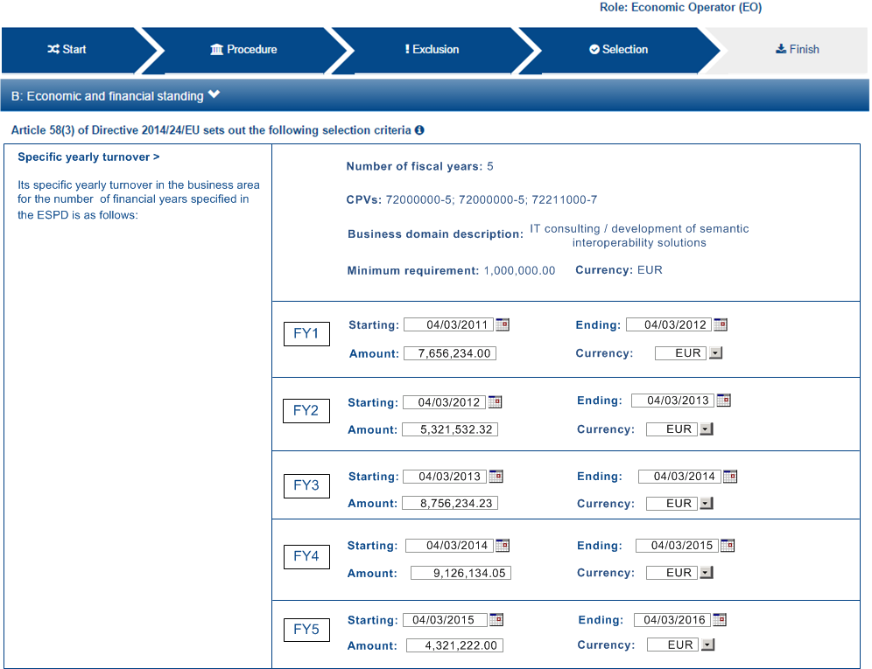
1
2
3
4
5
6
7
8
9
10
11
12
13
14

Slide 68
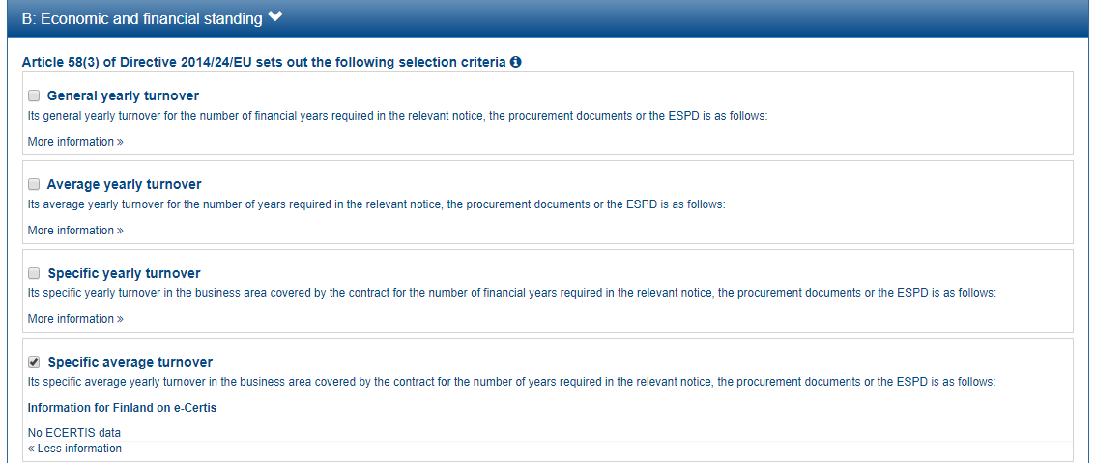

Slide 69
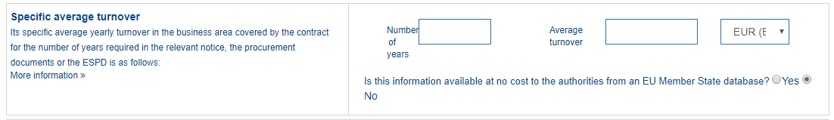
1
2
3

Slide 71
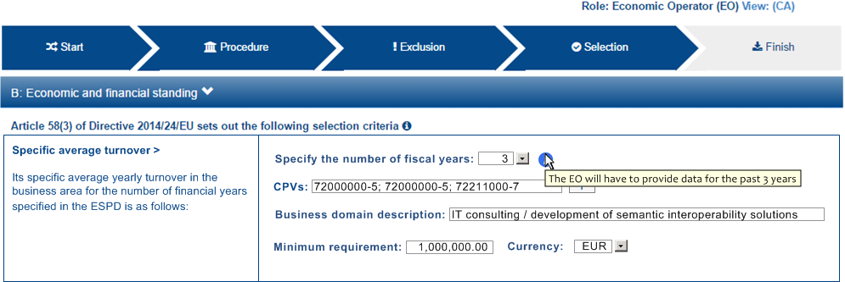
1
2
3
4

Slide 72
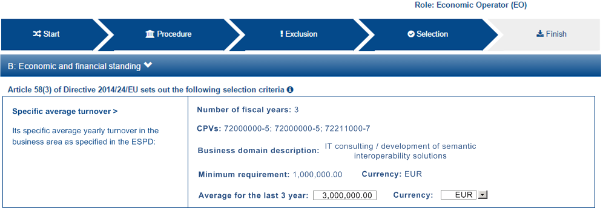
1
2
3
4
5

Slide 74
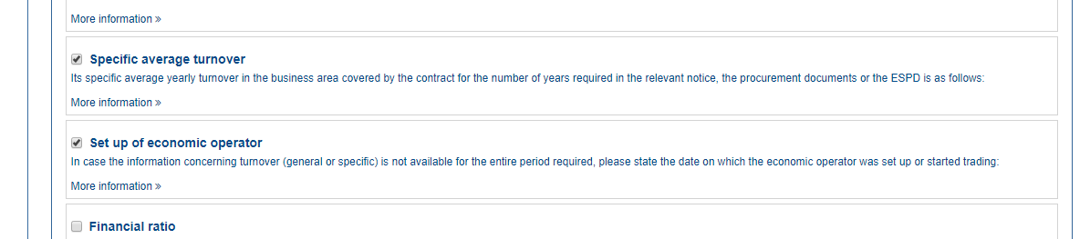

Slide 75
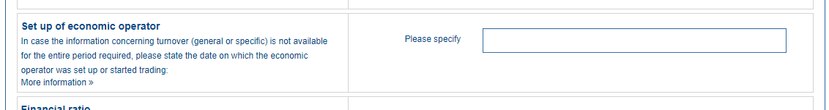
1

Slide 78
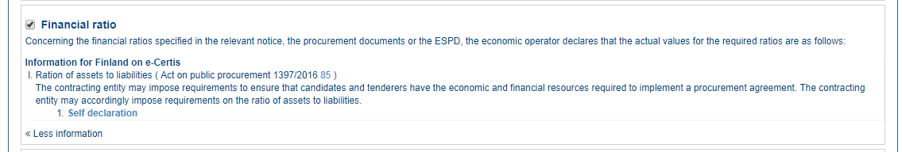

Slide 79
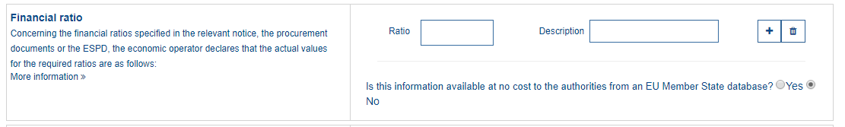
1
2

Slide 81

1
2
3
4
5
6
7
8
9
10

Slide 82


Slide 84


Slide 85

1

Slide 88

1
2

Slide 89

3
1
2

Slide 90

3
1
2
4
5

Slide 92


Slide 93

1

Slide 95

1
2
3
4
5
6
7
8

Slide 96

9
1
3
4
5

Slide 98


Slide 99

1
2
3
4

Slide 101

1
2

Slide 102

3
4
5
6
7
8
9
10
1
2

Slide 104


Slide 105

1
2

Slide 107

1

Slide 108

1
2
3
4
5
6
7
8
9
10
11

Slide 110


Slide 111


Slide 112

1

Slide 115

1

Slide 116

1
2

Slide 118


Slide 119

1
2
3
4

Slide 122

1
2

Slide 123

3
1
4
2
5

Slide 125


Slide 127


Slide 128


Slide 131


Slide 132

1
2

Slide 134

1

Slide 135

1
2
3
4
5

Slide 137
1
2
3

Slide 138


Slide 139


Slide 141


Slide 142
1
2
3
4
5

